Slide 1
How to Save the Environment; or Why Nobody Takes your Security Advice
Daniel “unicornFurnace” Crowley

Slide 2
Background
Living with the environmentally conscious

Slide 3
Why?
We have been jaded by our work
We inherently distrust the systems we see broken daily
We know that breaches are costly
People understand that computer security is good
But it isn’t much of a priority for Joe Q. Public
Everyone in this room wants
Clean air
Clean water
A good future for the Earth
…but we don’t all know the gravity of the situation

Slide 4
Disclaimer
I am not an environmental expert
This talk is not meant to give real environmental advice
Environmental advice in this talk may not be sound
It’s probably really impractical anyway
My background is in information security

Slide 5
How to recycle
In three easy steps

Slide 6
Recycling
Recycling is important for a healthy Earth
Some materials can be renewed
Reduces consumption of new resources
Recycling is easy!

Slide 7
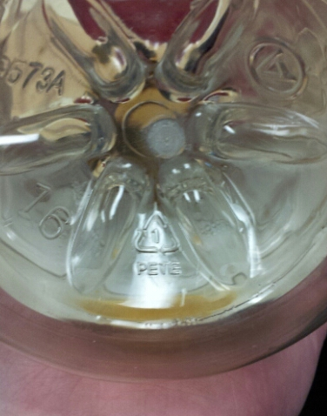
How to recycle
Look for the recycling symbol
Toss it in your recycling bin
Nice people take it away and recycle it

Slide 8
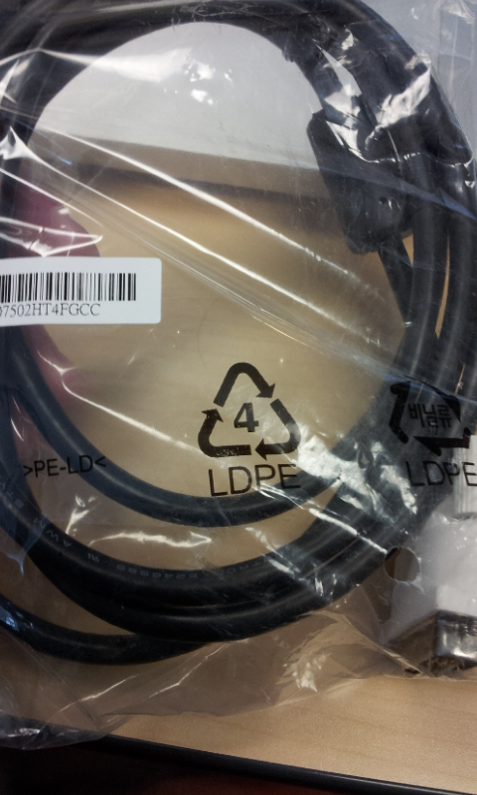
No wait
What does that number mean
Oh nuts you can’t recycle this one
Wait, maybe
Oh god styrofoam is #7

Slide 9
How to recycle
Look for the recycling symbol
Check if it’s #1, 4, or 5
Toss it in your recycling bin
Nice people take it away and recycle it

Slide 10
Oh, sorry, my mistake, hold on
Some recycling centers won’t accept certain numbers
Curbside pickup recycling is often more picky
Different places accept different materials
Public recycling bins are uncommon in U.S.
And you don’t know what they’ll accept

Slide 11
How to recycle
Carry a bag with you for recyclables
Look for the recycling symbol
Check the number
Call your local recycling center
Toss it in your recycling bin
Nice people take it away and recycle it

Slide 12
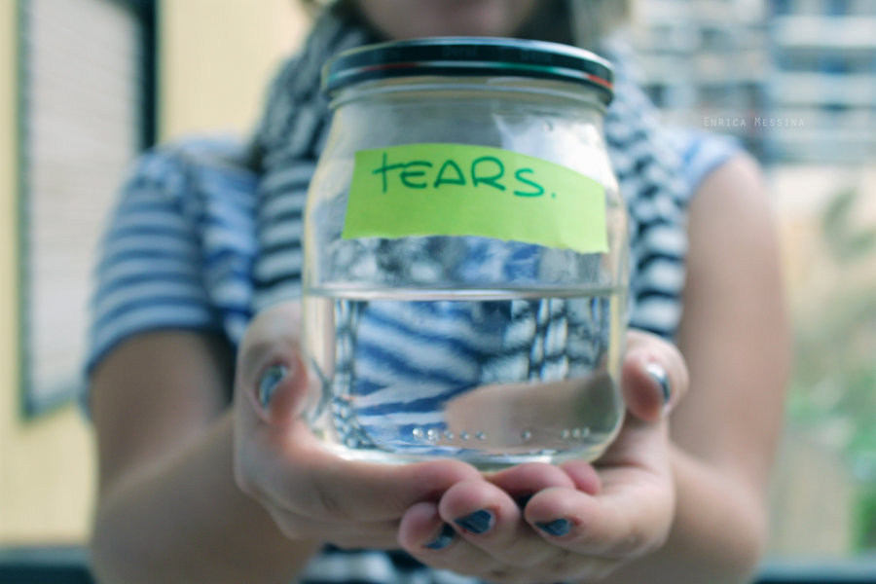
OH COME ON
These rules only apply to plastics

Slide 13
How to recycle
Throw it all in the recycling bin
Let someone else deal with it

Slide 14
Cryptography
Normal advice
Better advice
Use a known good algorithm
Use different keys (IV if applicable) for each operation
Rotate keys periodically
Use an authenticated cipher mode if possible
If not, apply an HMAC
Only after encryption
Use a high level library
NaCl
Keyczar
Mackerel (not yet out)
Let the library maintainer deal with it

Slide 15
Memory corruption
Normal advice
Better advice
Don’t use banned functions
gets
strcpy
strcat
etc
Never used fixed length buffers
Only call free() once
Don’t use freed memory
Use a language that manages memory for you

Slide 16
saving water
A surprisingly precious resource

Slide 17
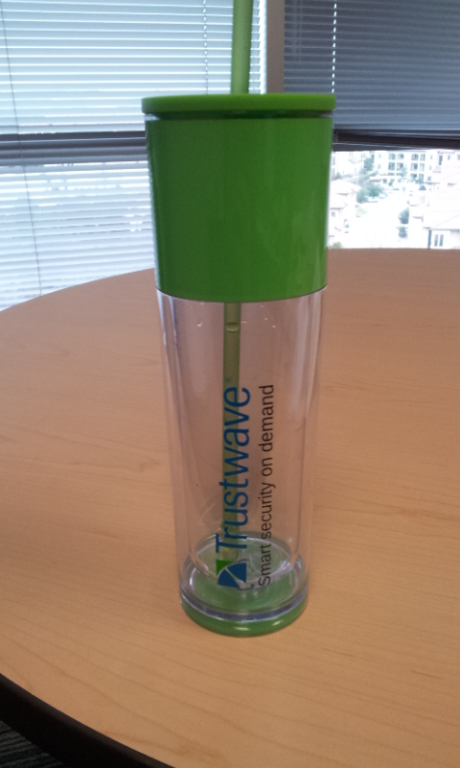
The importance of fresh water
Water is the most plentiful substance on Earth
Fresh water is not
Important for:
Drinking
Cooking
Cleaning

Slide 18
Tips for conserving water
Limit length of showers
Put a plastic bottle with sand and water in toilet tanks
Urinate in the shower
Only wash full loads in dishwasher/clothes washer
Check for leaks in pipes, toilets, sinks, etc

Slide 19
Tips for conserving water
Limit length of showers
Put a plastic bottle with sand and water in toilet tanks
Urinate in the shower
Only wash full loads in dishwasher/clothes washer
Check for leaks in pipes, toilets, sinks, etc

Slide 20
Tips for conserving water
Limit length of showers
Put a plastic bottle with sand and water in toilet tanks
Urinate in the shower
Only wash full loads in dishwasher/clothes washer
Check for leaks in pipes, toilets, sinks, etc

Slide 21
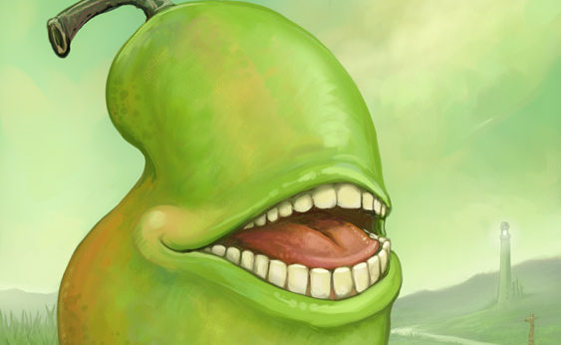
WAIT WUT
Creative commons image, original by Ursula Vernon

Slide 22
Tips for conserving water
Limit length of showers
Put a plastic bottle with sand and water in toilet tanks
Urinate in the shower
Only wash full loads in dishwasher/clothes washer
Check for leaks in pipes, toilets, sinks, etc

Slide 23

MFW “pee in shower”
Creative commons image by epicnoriko123, deviantart

Slide 24
Physical security
Normal advice
Better advice
Don’t hold doors for other people
Keep your computer locked
Always have guests attended by an escort
Use man traps
Set aggressive screen lock policies

Slide 25
Reducing petroleum consumption
Good for you and the Earth!

Slide 26
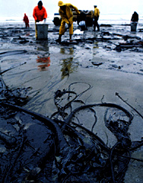
Pollution from petroleum-based energy
Ozone layer
Smog
Oil spills
Picture from US National Oceanic and Atmospheric Administration

Slide 27
Walk to work!
Save money on gas
Save money on car maintenance
Get more exercise
Reduce chance of injury or death in auto accidents
Reduce dependency on foreign countries

Slide 28
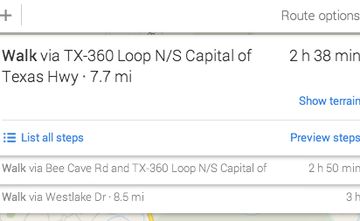
>nope.avi

Slide 29
Password security practices
Normal advice
Better advice
Choose a password that is:
At least 8 characters
Uses a mix of:
Upper case
Lower case
Numbers
Symbols
Not based on any dictionary word
Never reuse passwords
Never write passwords down anywhere
Use an encrypting password manager
Preferably with a 2FA option like KeePass w/a Yubikey
On a flash drive for portability
With randomly generated passwords
Remember one or two strong passwords for important services
Email, for emergency resets
Use passphrases where possible

Slide 30
Eco-Friendly packaging
Reduce the waste!

Slide 31
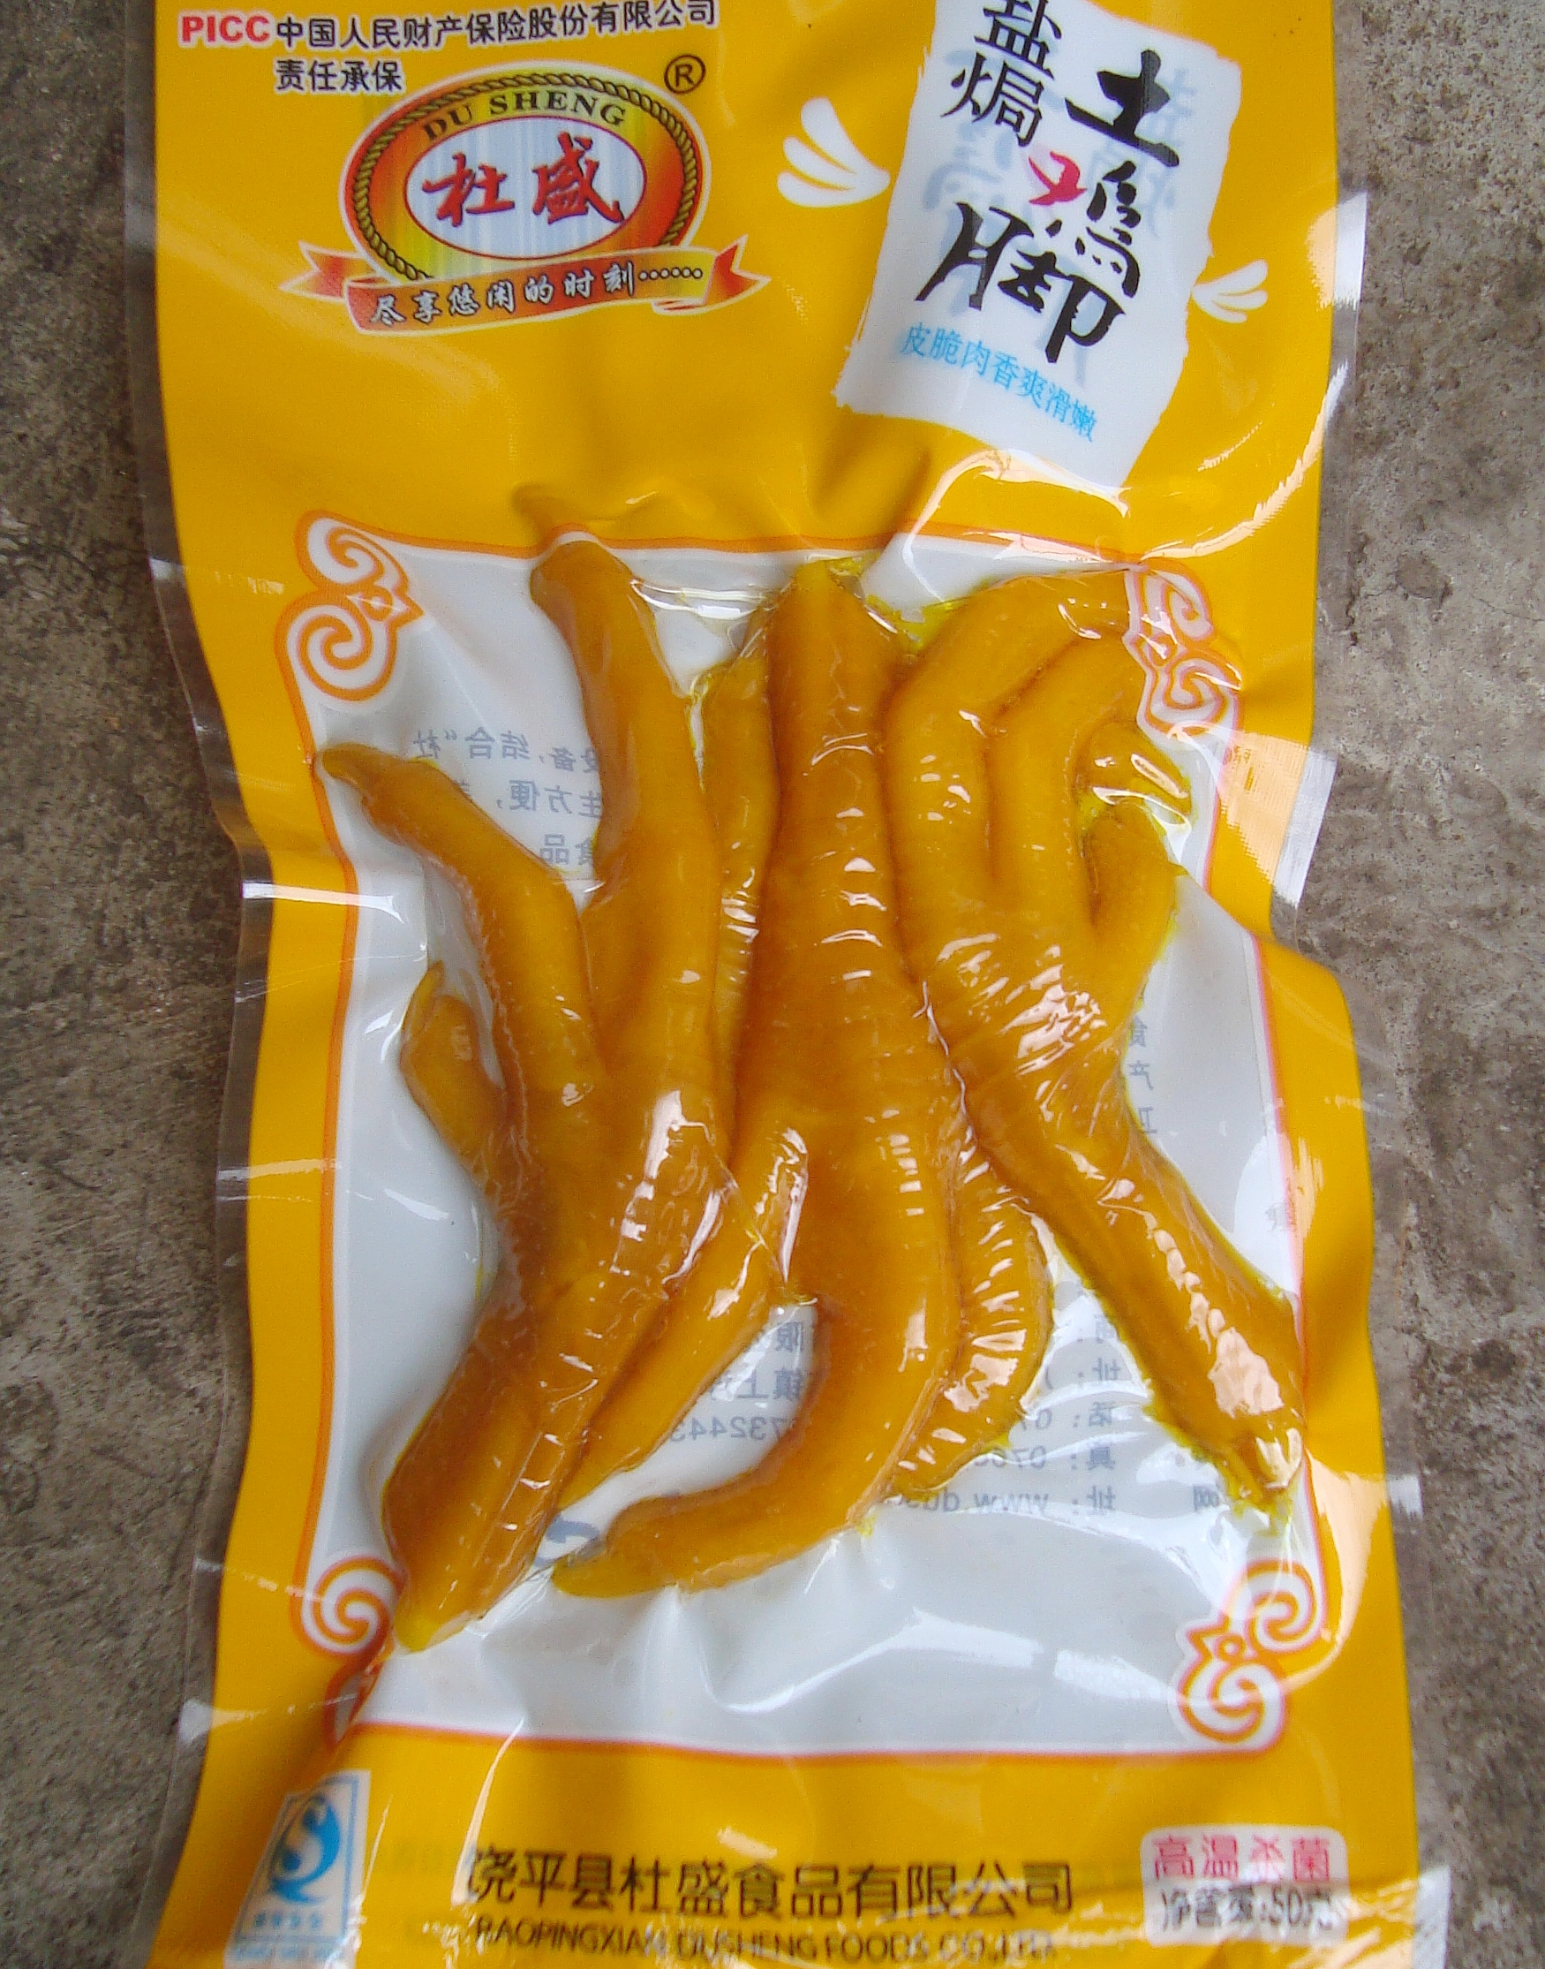
Packaging and the environment
Fills up landfills
Uses clean water and energy to produce
Often the source of litter
Photo courtesy Wikimedia Commons

Slide 32
Easy solutions!
Buy more unpackaged goods
Fruits
Vegetables
Avoid over-packaged goods
Buy goods in reusable packaging
Buy goods in recyclable packaging

Slide 33
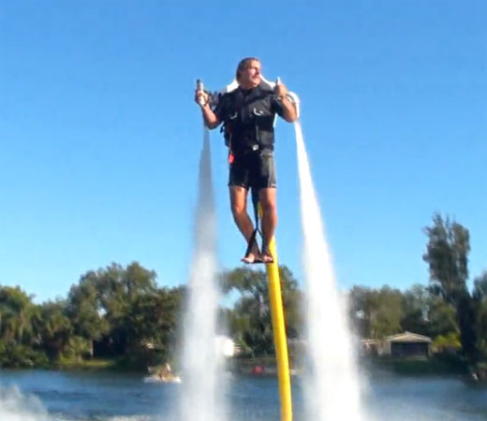
OH FUCK YES SOLD
Photo courtesy of Wikimedia Commons

Slide 34
Anti-phishing advice
Normal advice
Better advice
Never visit websites you don’t trust
Don’t click links in email from unknown parties
Don’t click links you weren’t expecting to receive
Always check links before you click them
Don’t do work on personal machines
Don’t play on work machines
Ask for confirmation from known senders

Slide 35
Conclusion

Slide 36
Review of factors
Complexity
Might be ignored out of laziness
Might be followed incorrectly out of ignorance
Social norms
Might be ignored due to social pressure
Human nature
Might undermine good intentions
Scalability
Might render good advice useless

Slide 37
QUESTIONS?
@dan_crowley dcrowley@trustwave.com

